Slide 1
DIGITAL TWIN REPRESENTATION OF FOLIAGE
HASHIM SHAIK
National University
Dissertation Chair: Dr. Irene Tsapara
Subject Matter Expert: Dr. Mohamed Nabeel
Academic reader: Dr. Lawrence Fulton
Notes:
SLIDE INSTRUCTIONS:
During this slide you should provide a brief introduction of yourself in the notes that you will share with the audience.
Your presentation should be approximately 30 minutes. Each slide will be around 1-2 minutes of discussion. Currently, there are 18 slides, excluding title slide, thank you slide, program evaluation slide, and reference slides. That will be roughly 18-36 minutes in length.
Depending on your study, you may need to add additional slides or remove slides. However, the basic setup should be the same and mirror the sections in the Dissertation Manuscript. Your Chair will review your presentation draft and offer suggestions prior to your actual presentation.
You may keep your presentation simple or add graphics as appropriate. If you add graphics, you need to consider their purpose as your committee, or the audience may ask why they were used. In other words, do not use graphics simply for aesthetic purposes.
POWERPOINT PRESENTATION INSTRUCTIONS FOR ALL SLIDES:
Avoid smaller than 18-point font and larger than 40-point font on slides. Be consistent in font usage.
Be consistent in font color – black works best.
Short bulleted points on slide. 3-6 bullets per slide. 3-6 words per bullet point. NOTE: The bullets are your talking points.
Use the Notes section below the slide for further information addressing the bullet points on the slide. You can read these notes as no one will see you doing so since your camera will be off when you start presenting.

Slide 2
RESEARCH DESIGN METHODS FOR DIGITAL TWIN REPRESENTATION OF FOLIAGE
Image Feature Extraction
Machine Learning Model Training
Model Evaluation
Data Fusion and Integration
Spatial Analysis
Temporal Analysis
Machine Learning Interpretability
Validation and Testing
Visualization and Reporting
Iterative Process
Comparison with LiDAR or UAV Data
Data Collection
Data Preprocessing
GIS Integration

Slide 3
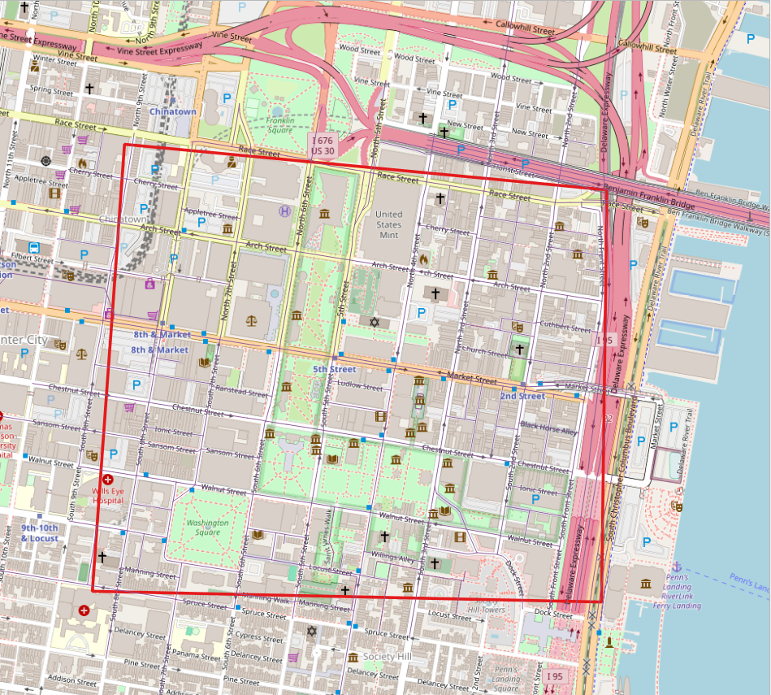
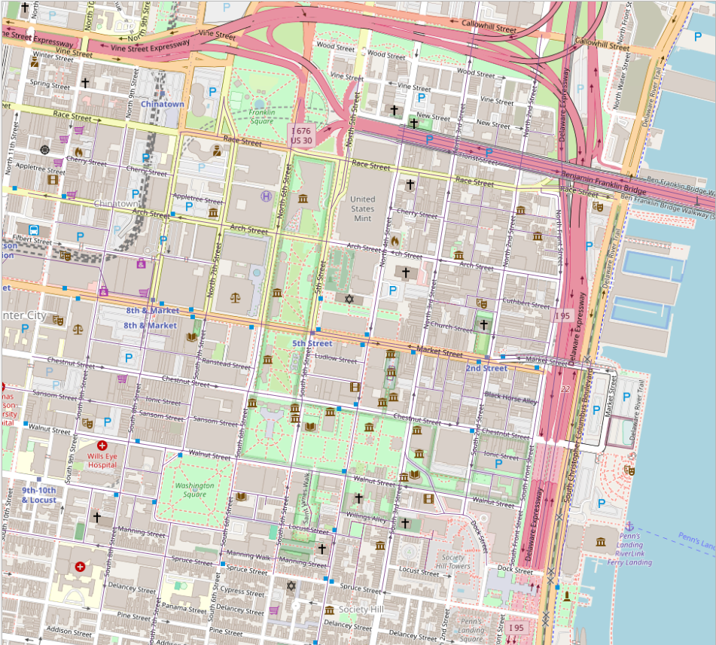
Selected 11.67 sq. km.
SELECT THE AREA WHERE THE DTRF SHOULD BE BUILT
- The historic downtown Philadelphia area
Philadelphia - Downtown

Slide 4
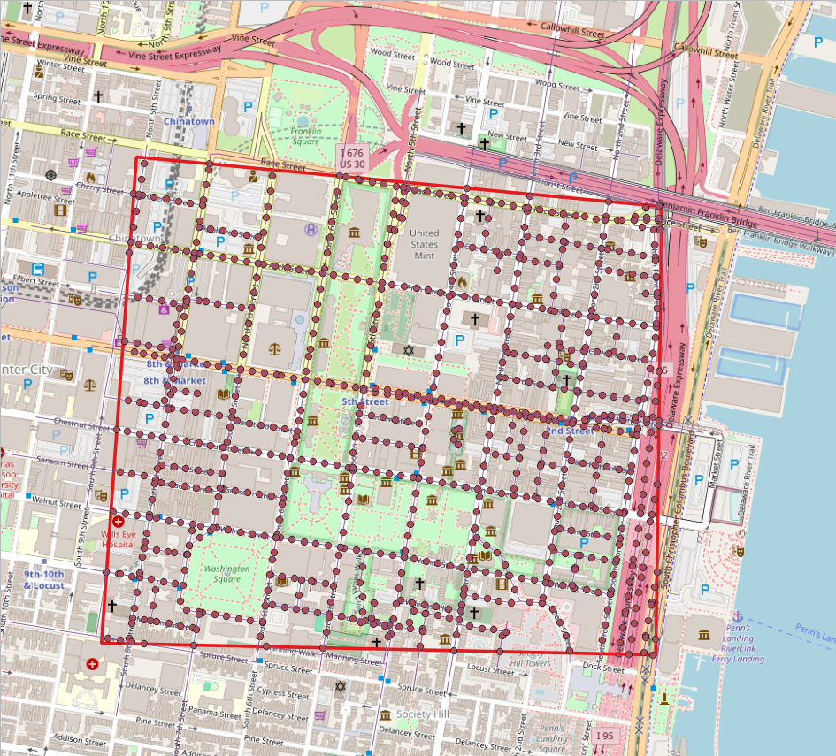
PLACE THE POINTS ALONG THE ROADS OF THE SELECTED REGION
- close 932 points placed with 30meters apart

Slide 5
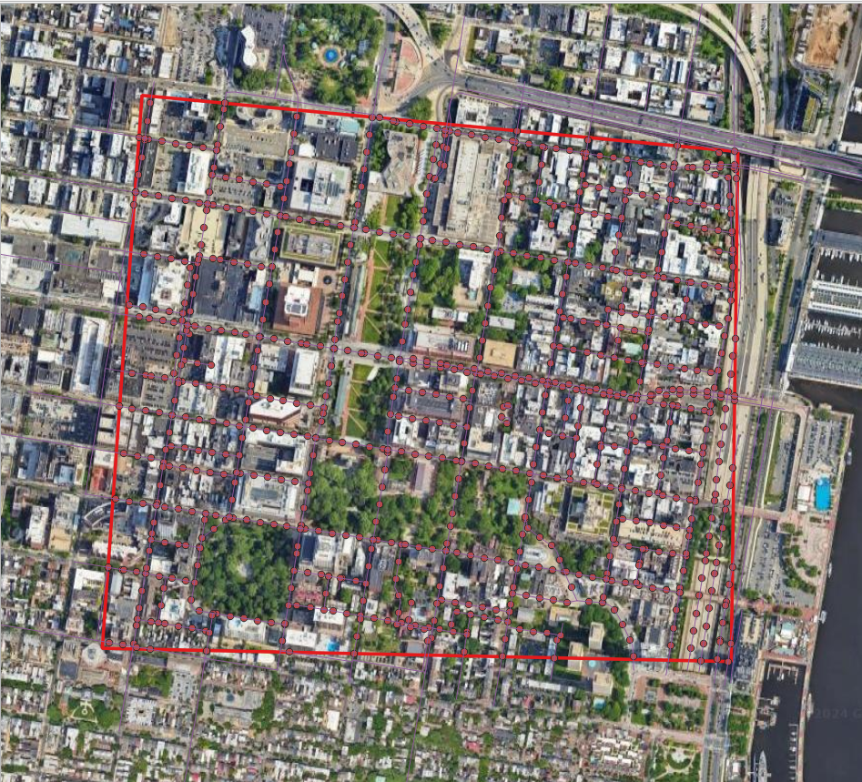

Slide 6
DATA COLLECTED WITH LAT/LON COORDINATES
(TO COLLECT AERIAL IMAGES)
fid | osm_id | name | highway | angle | xcoord | ycoord
1 | 12109179 | North Independence Mall East | secondary | 9.690751635 | -75.1484825 | 39.9525908
1 | 12109179 | North Independence Mall East | secondary | 9.254043699 | -75.14842308 | 39.95288476
2 | 12111583 | Boudine Street | service | 12.10132399 | -75.1453782 | 39.9492774
2 | 12111583 | Boudine Street | service | 12.10132399 | -75.14531531 | 39.94957073
2 | 12111583 | Boudine Street | service | 12.10132399 | -75.14525242 | 39.94986407
3 | 12112672 | South 4th Street | residential | 198.0470502 | -75.1472643 | 39.9503257
3 | 12112672 | South 4th Street | residential | 192.2139097 | -75.14733557 | 39.9500346
3 | 12112672 | South 4th Street | residential | 192.2203966 | -75.14739905 | 39.94974139
3 | 12112672 | South 4th Street | residential | 186.3123648 | -75.1474582 | 39.94944748
3 | 12112672 | South 4th Street | residential | 192.2780733 | -75.14751386 | 39.94915302
3 | 12112672 | South 4th Street | residential | 191.7064367 | -75.14757721 | 39.94885978
4 | 12114293 | Bingham Court | footway | 278.2650676 | -75.1473866 | 39.94628
4 | 12114293 | Bingham Court | footway | 277.0542517 | -75.14768355 | 39.94632263
4 | 12114293 | Bingham Court | footway | 193.2198359 | -75.14780299 | 39.94610354
5 | 12114967 | Appletree Street | residential | 97.14994707 | -75.153031 | 39.953651
5 | 12114967 | Appletree Street | residential | 97.14994707 | -75.15273333 | 39.95361366
5 | 12114967 | Appletree Street | residential | 97.14994707 | -75.15243567 | 39.95357632
5 | 12114967 | Appletree Street | residential | 97.14583006 | -75.152138 | 39.953539
5 | 12114967 | Appletree Street | residential | 97.14583006 | -75.15184033 | 39.95350168

Slide 7
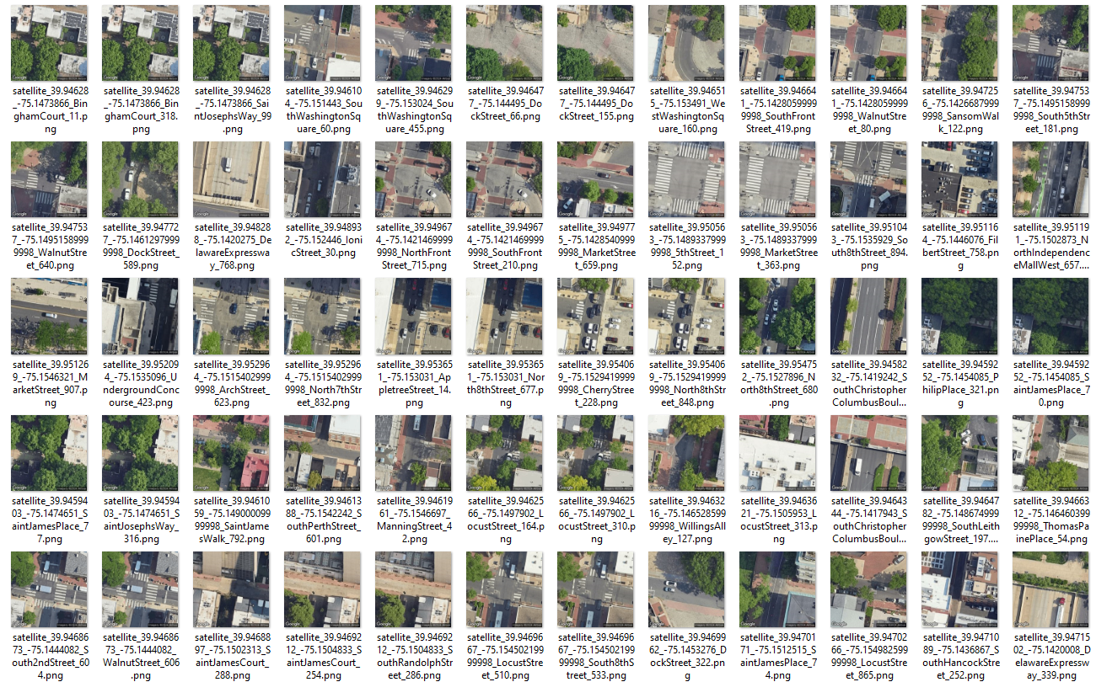
Sample Google Satellite/aerial image Data

Slide 8
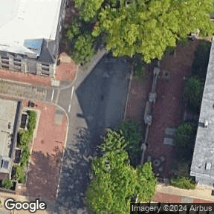
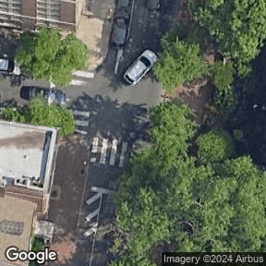
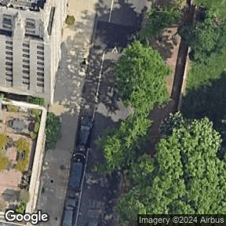
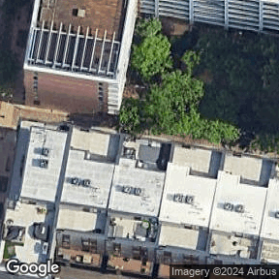
288 pixels
288 pixels
288 pixels
288 pixels
288 pixels
288 pixels
288 pixels
288 pixels

Slide 9
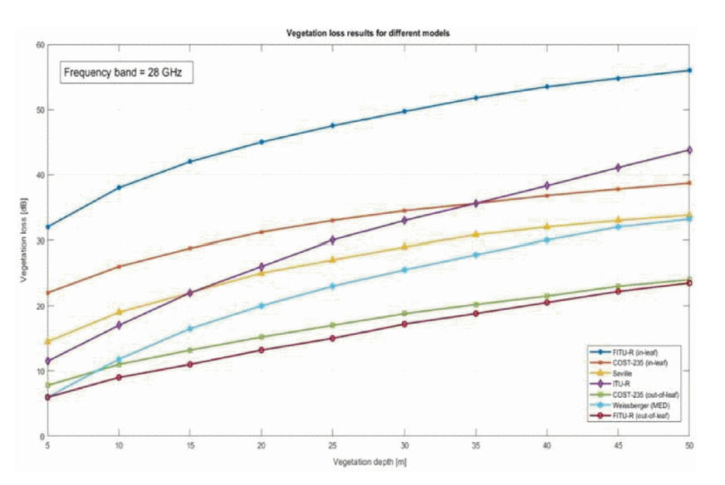

Slide 10
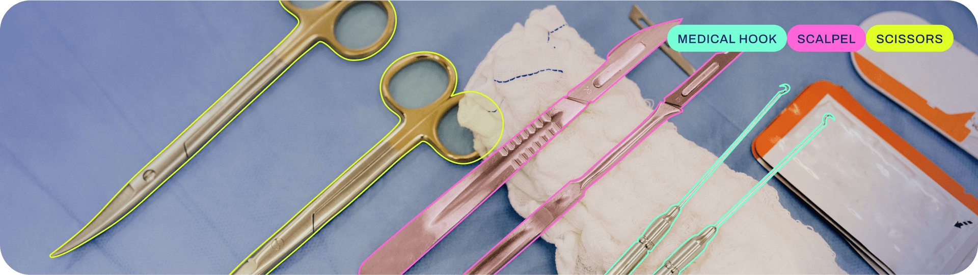
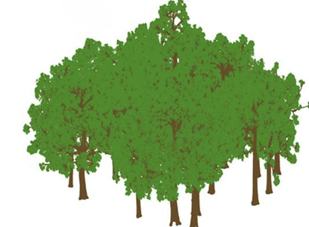
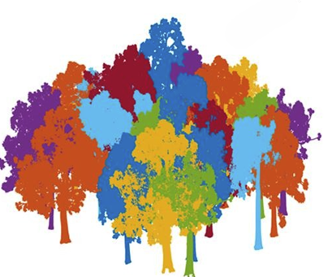
YOLOV8 - INSTANCE SEGMENTATION
Note: image is taken from https://docs.ultralytics.com/tasks/segment/
Notes:
https://doi.org/10.1016/j.isprsjprs.2020.04.020

Slide 11
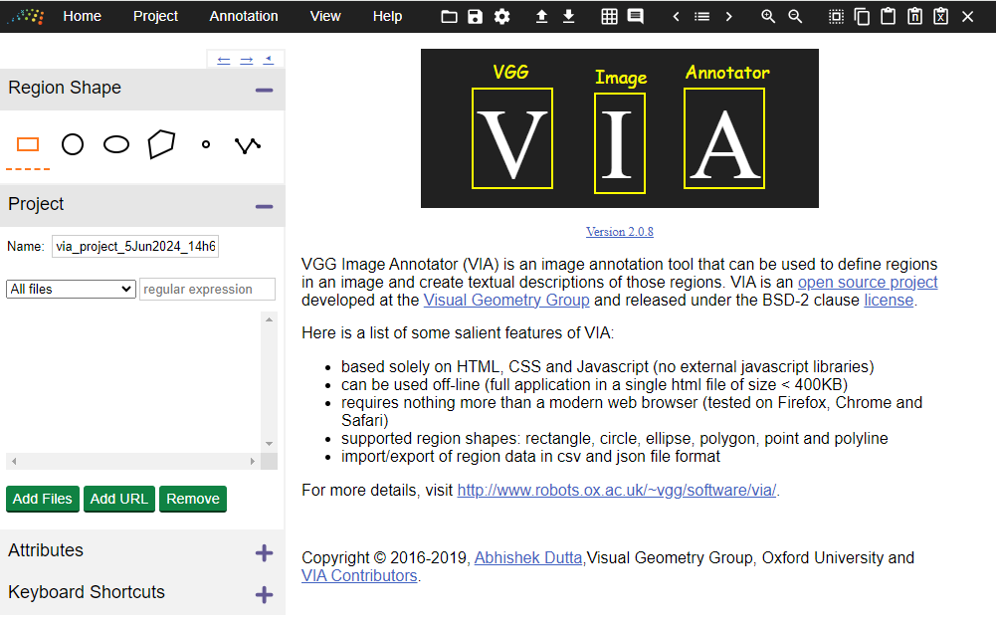
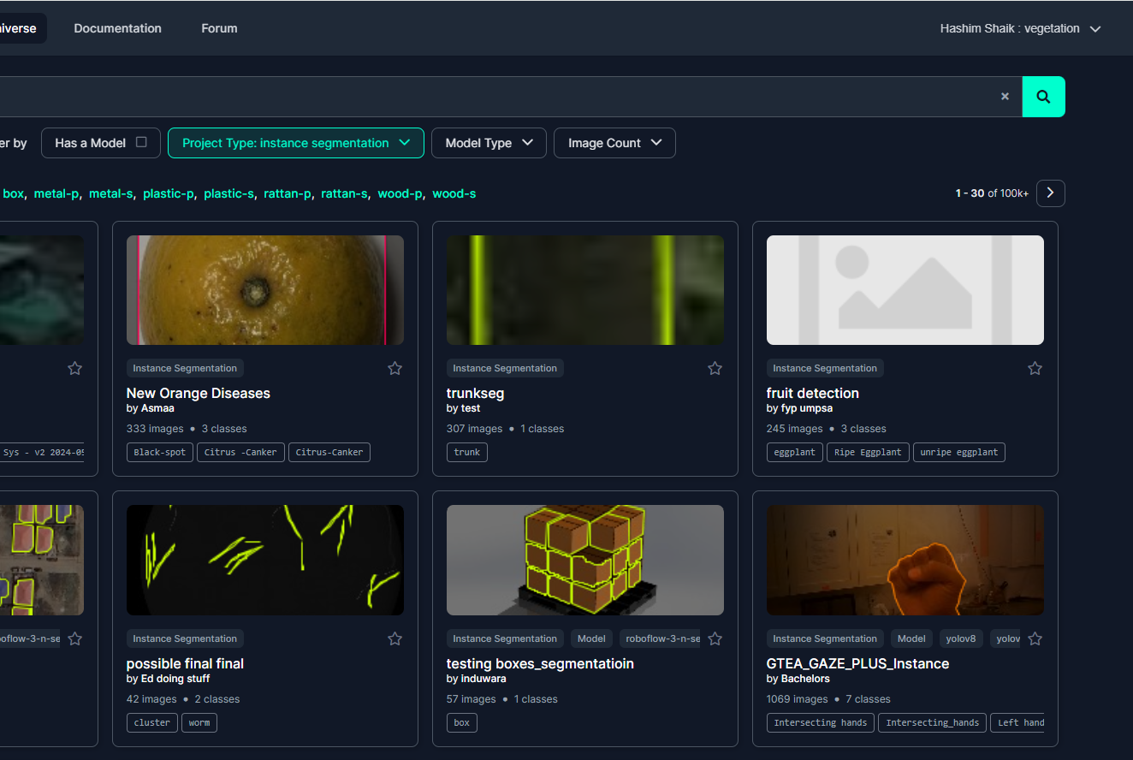
ANNOTATION TOOLS THAT SUPPORT YOLO FORMAT
VIA (VGG Image Annotator) – open source
Roboflow – free trail version

Slide 12
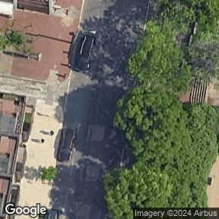
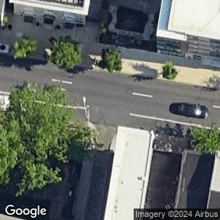
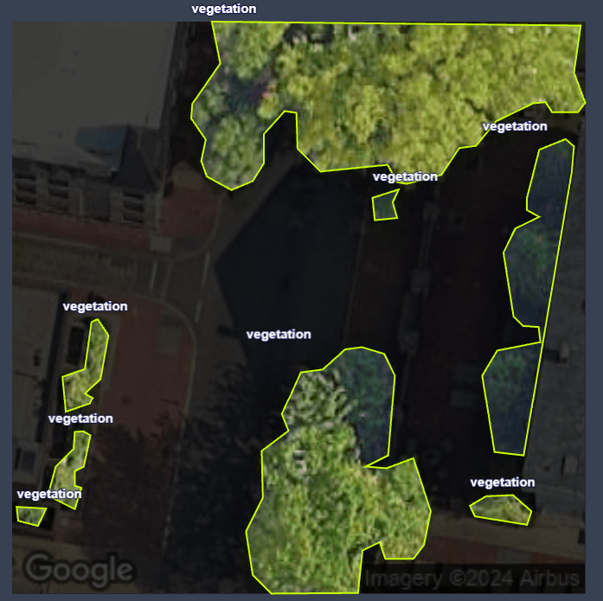
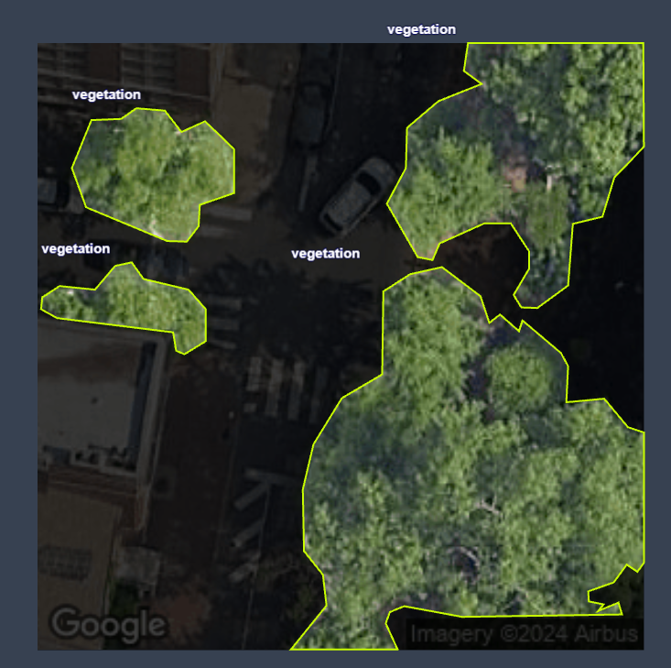
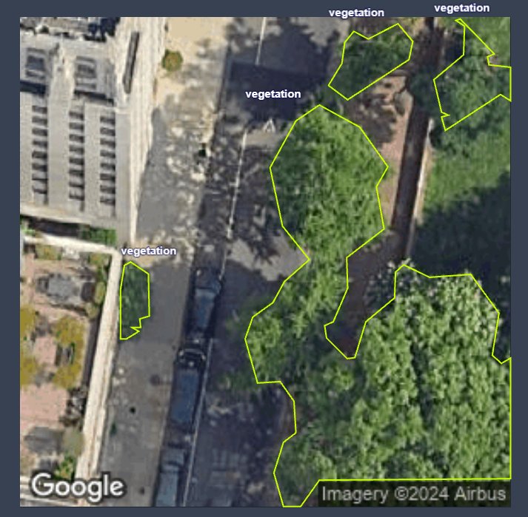
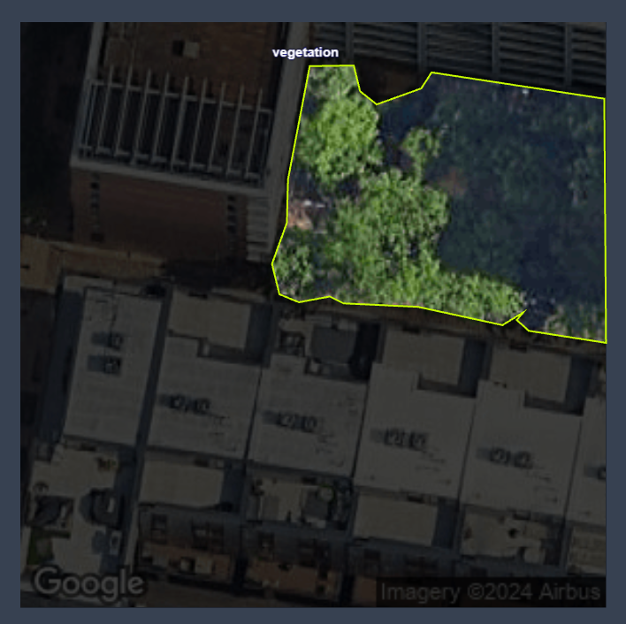
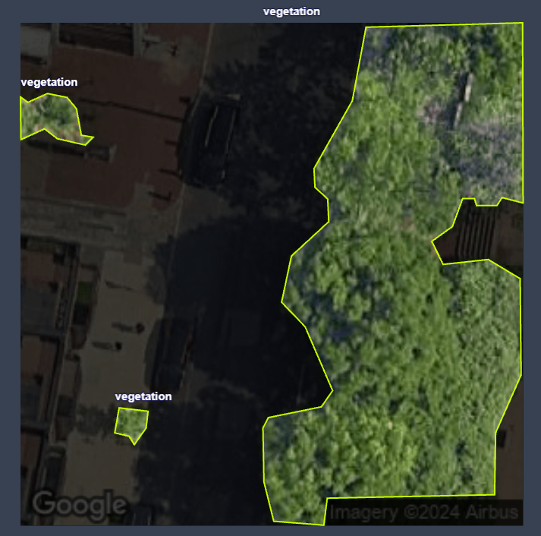
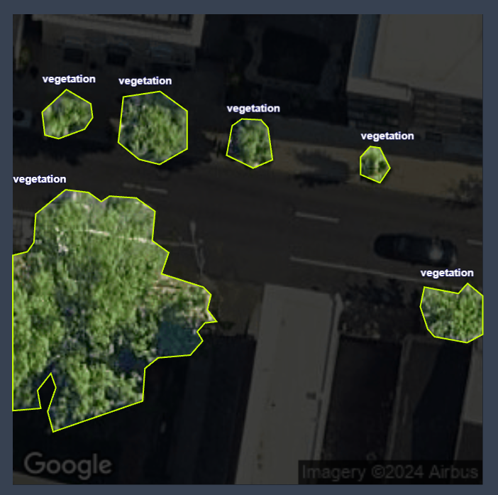
ANNOTATING VEGETATION/FOLIAGE DATA ON AERIAL IMAGES

Slide 13
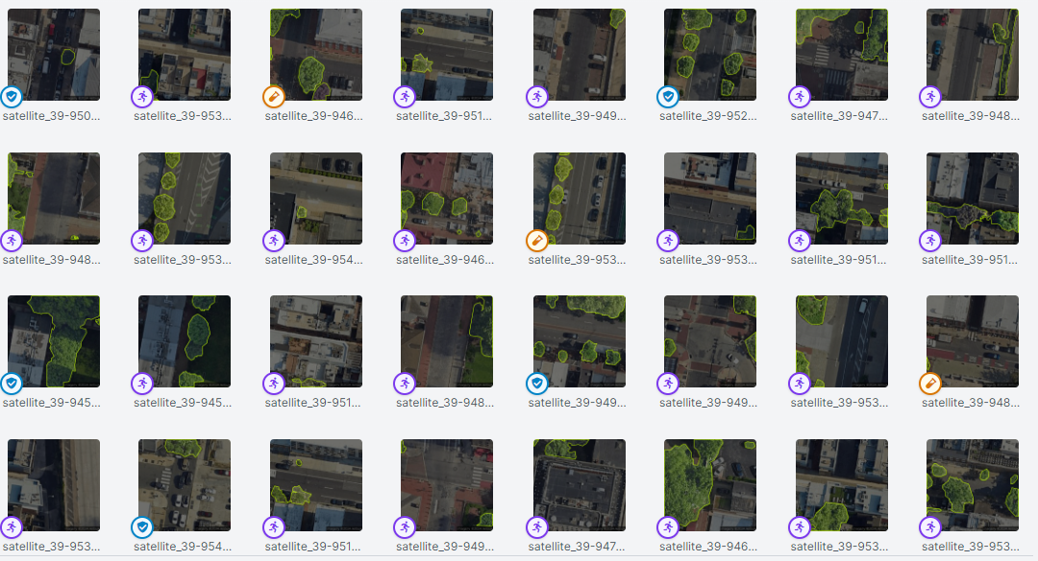
SPLIT THE SAMPLE DATA INTO TRAIN(70%)-VAL(20%)-TEST(10%)

Slide 14
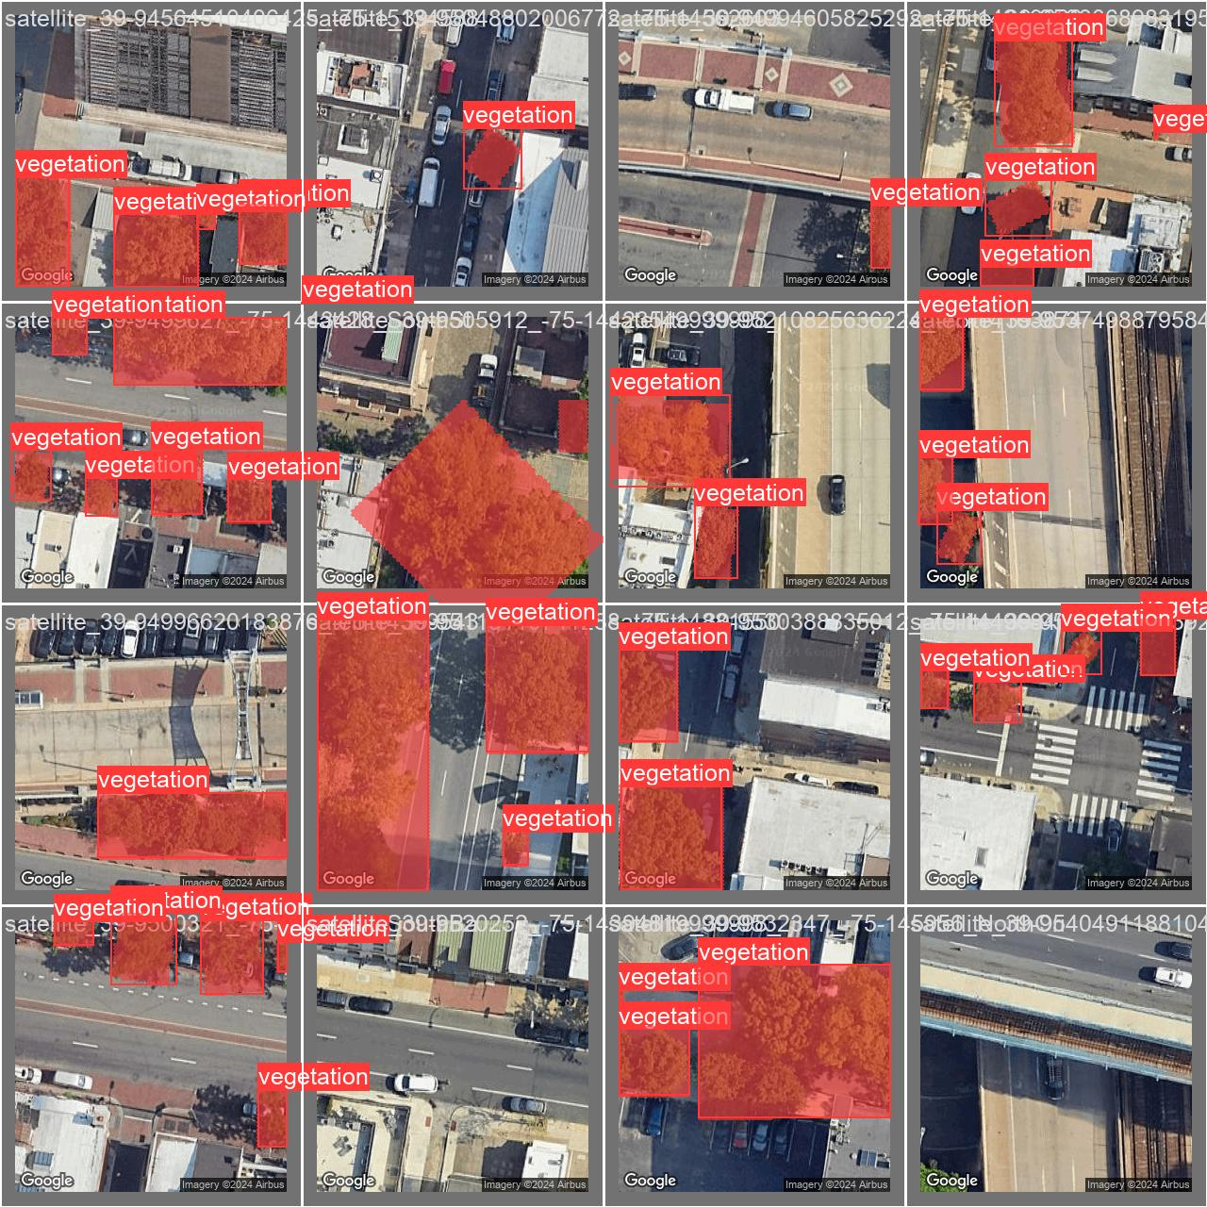
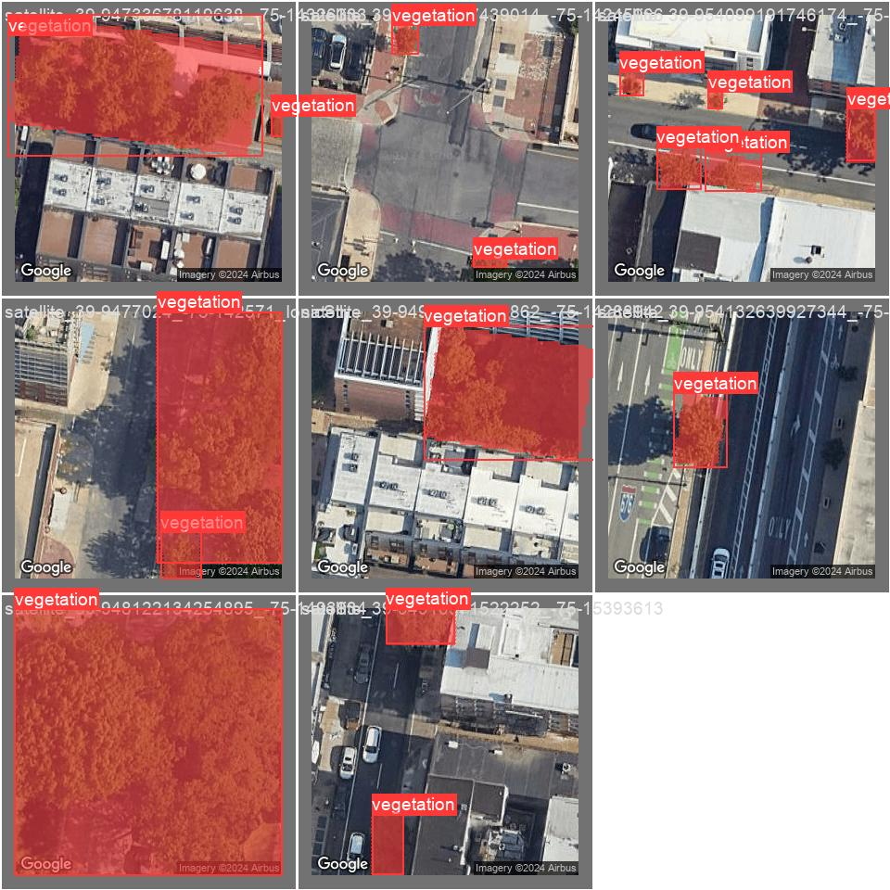
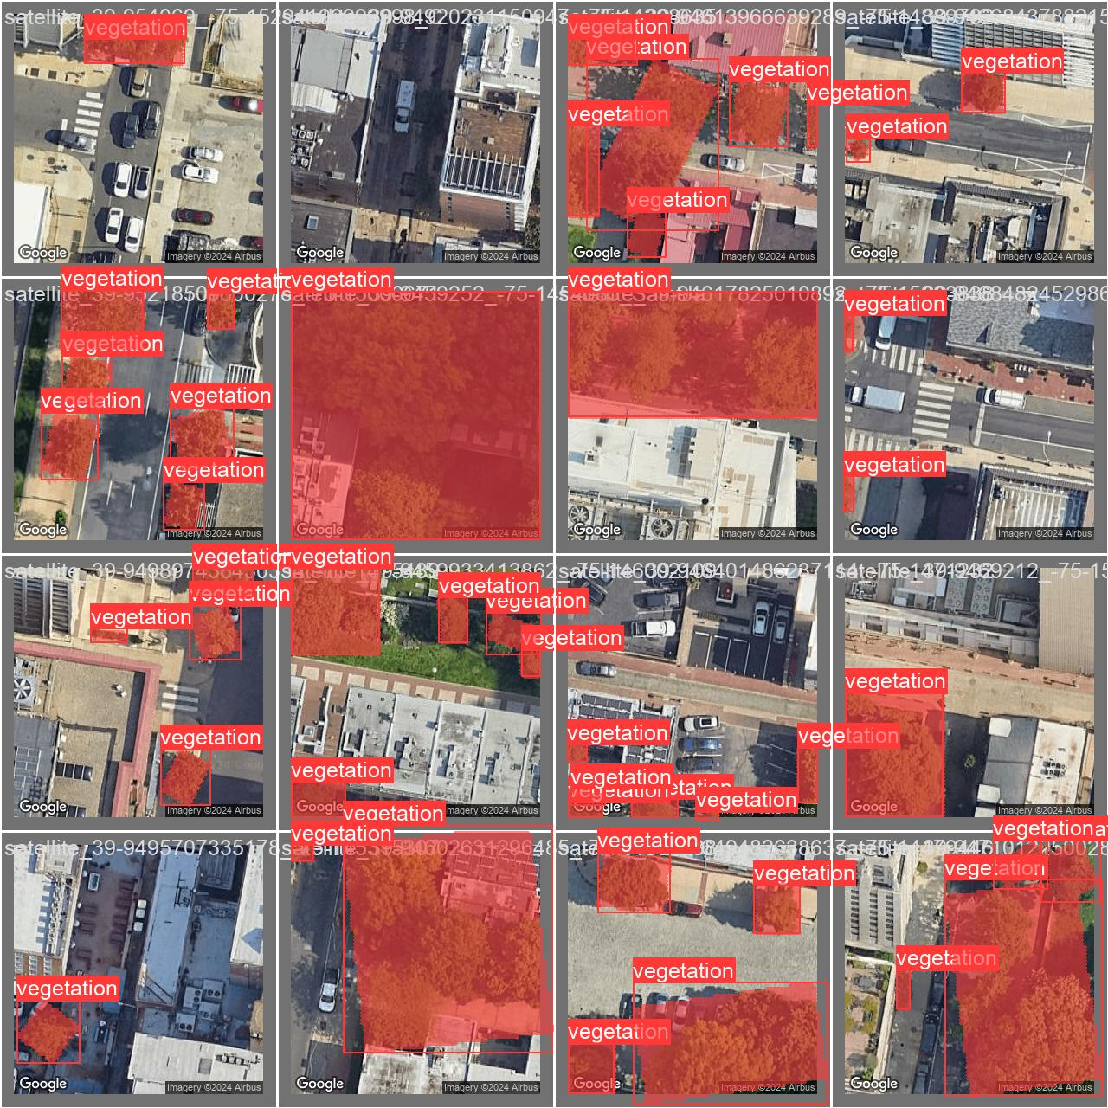
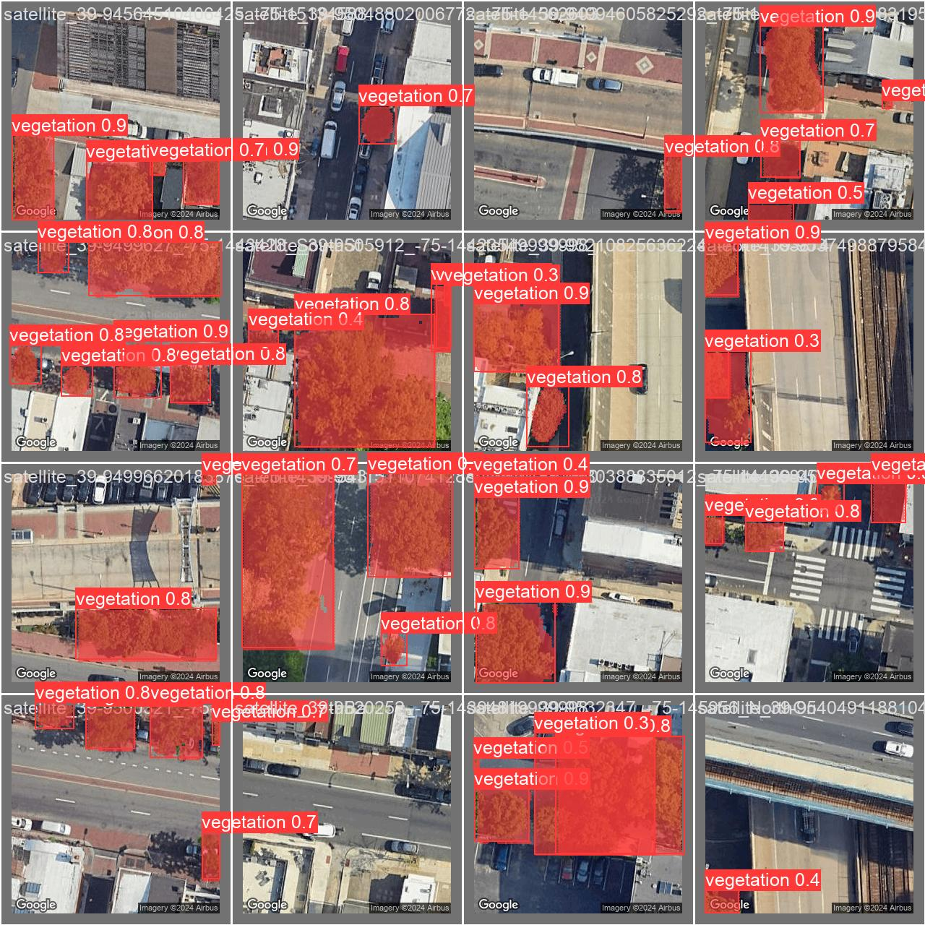
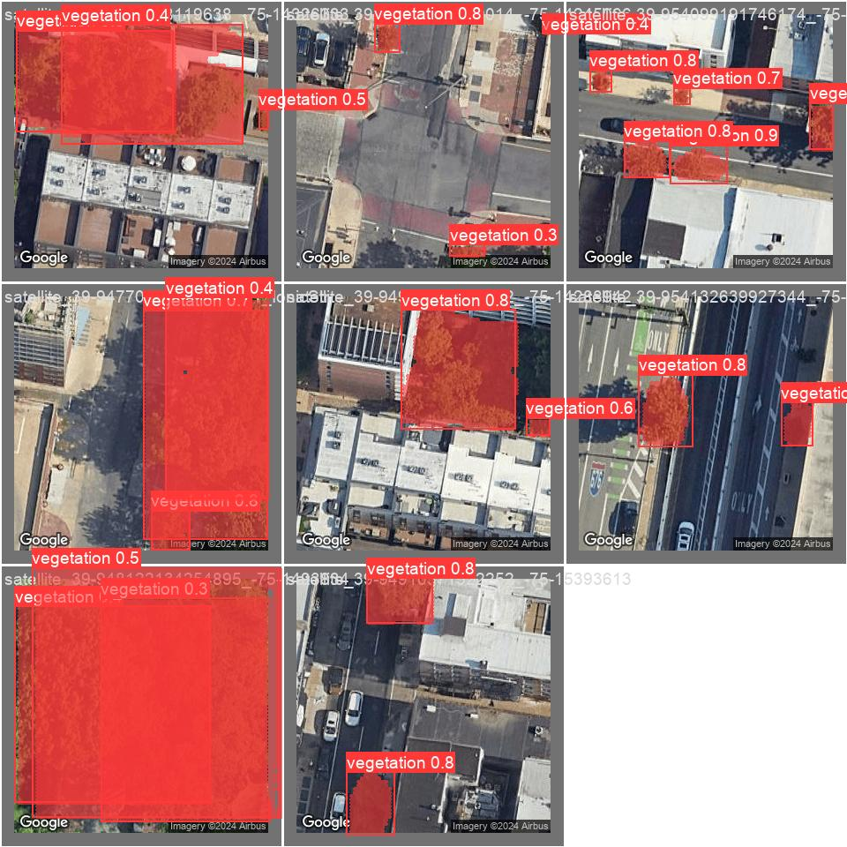
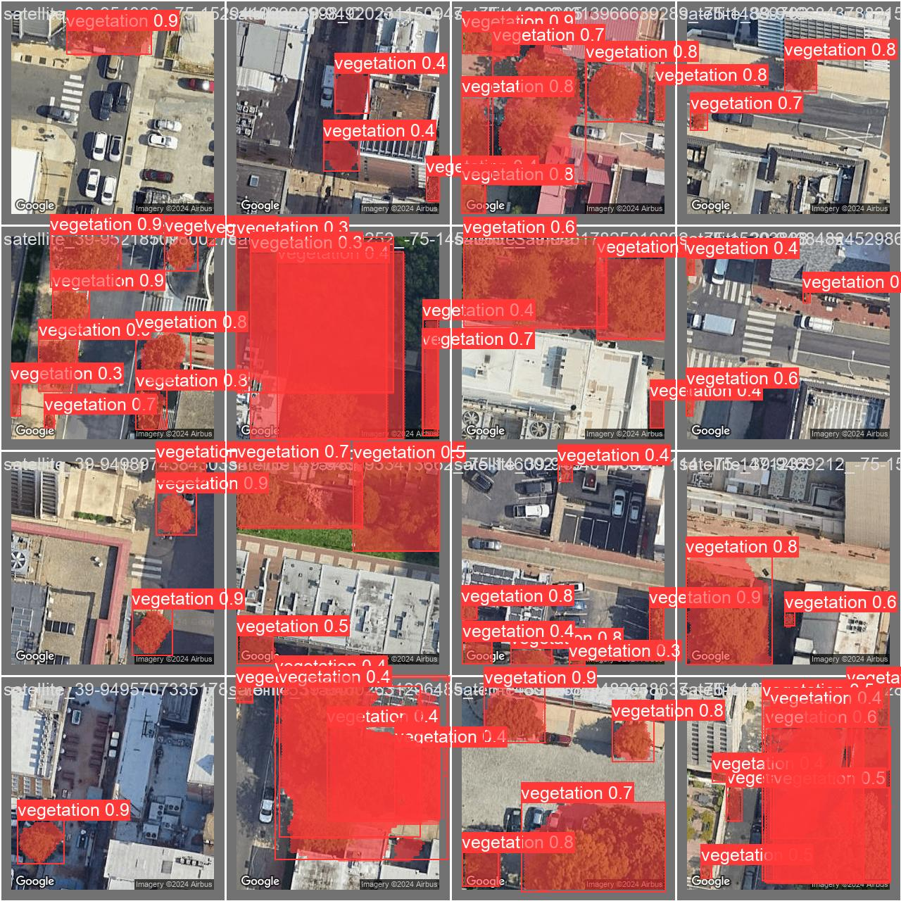
VALIDATION (ORIGINAL) VS VALIDATION WITH INFERENCE
Validation
Prediction on validation

Slide 15
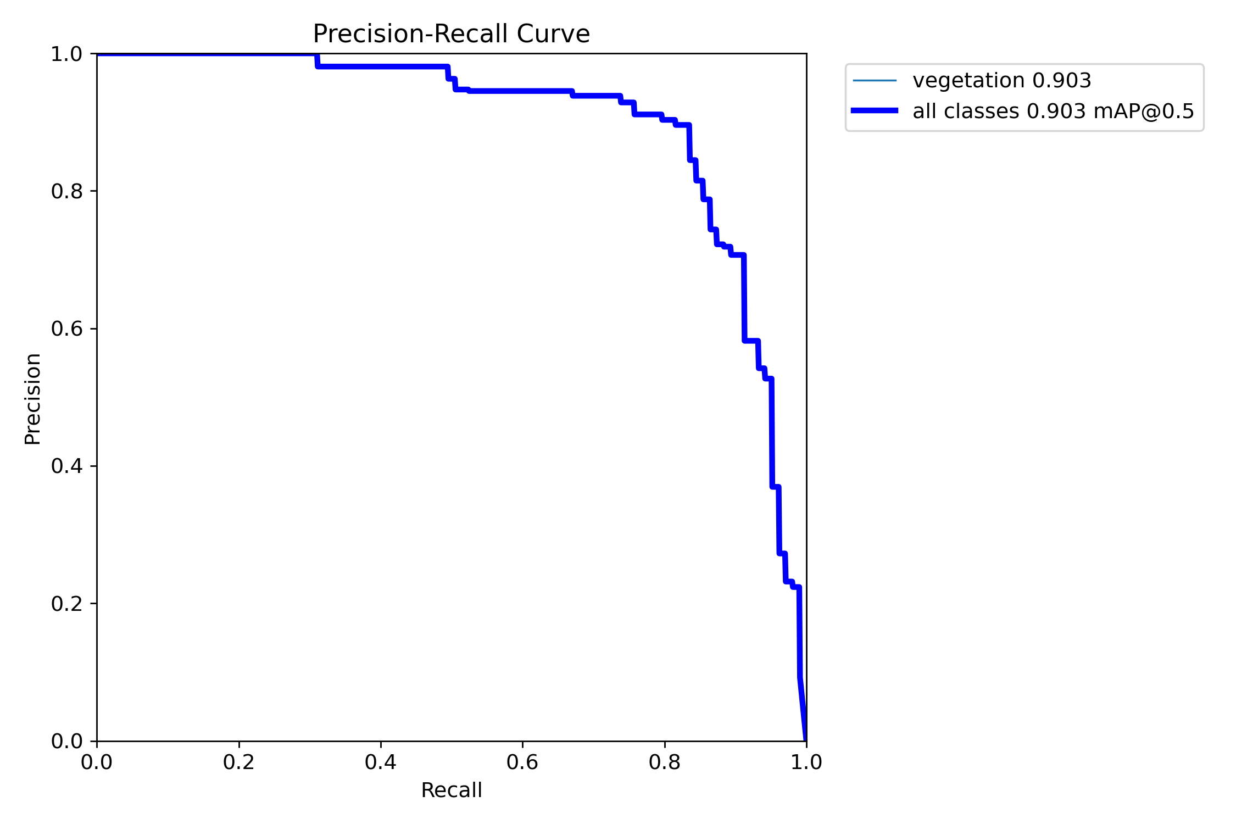
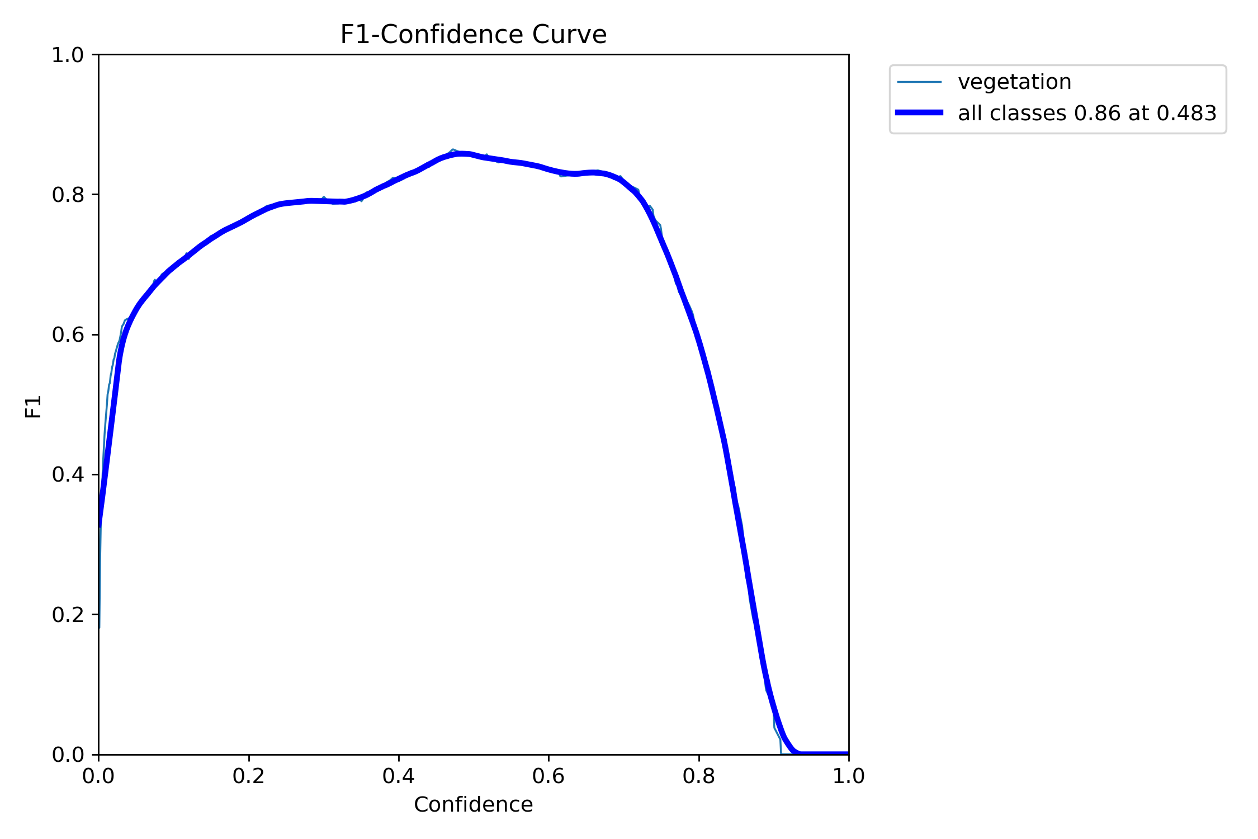
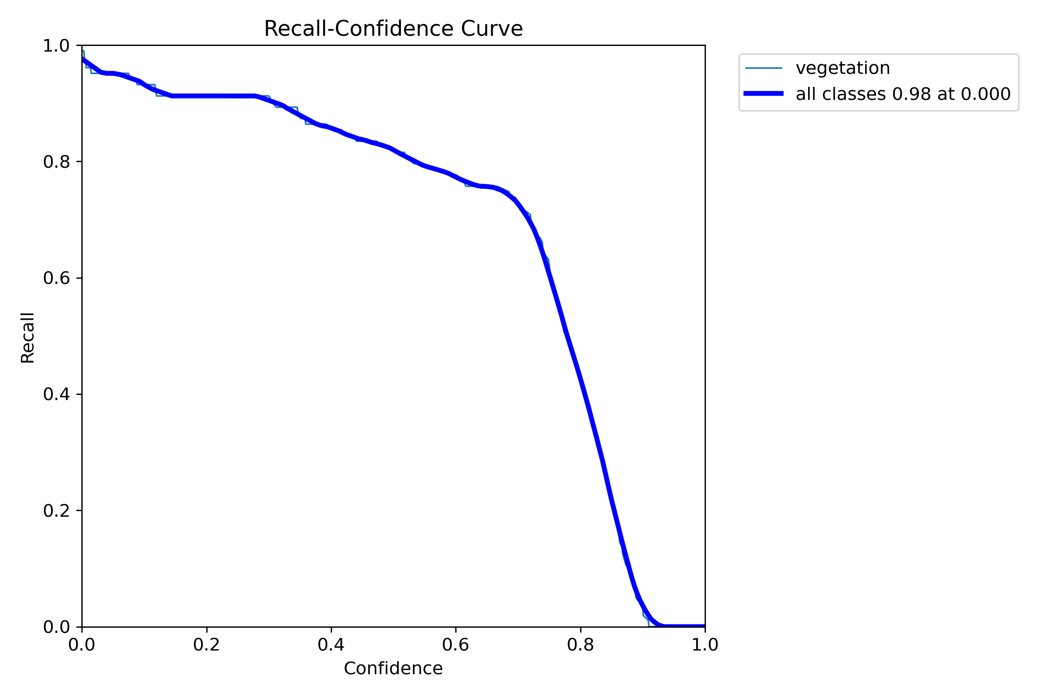
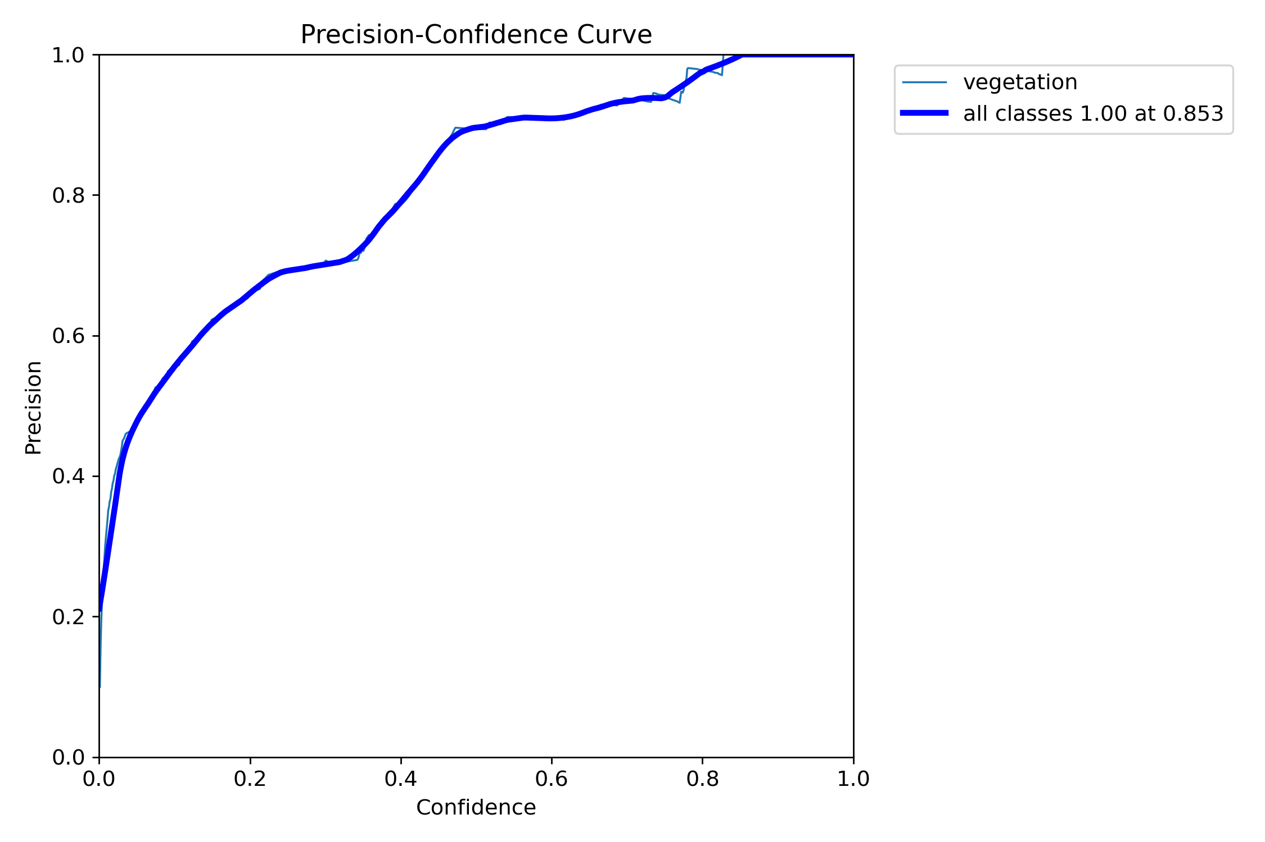
Bounding Box

Slide 16
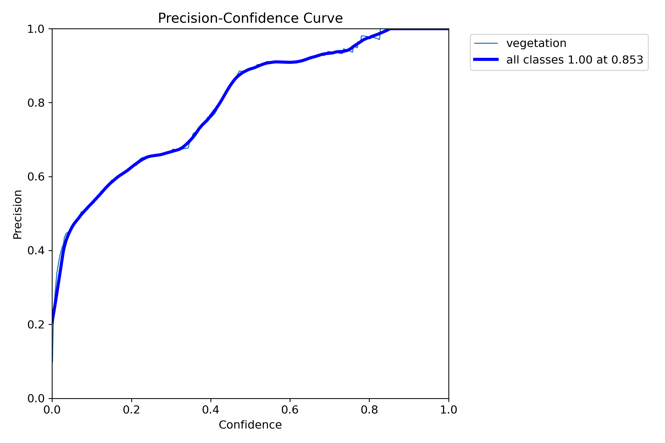
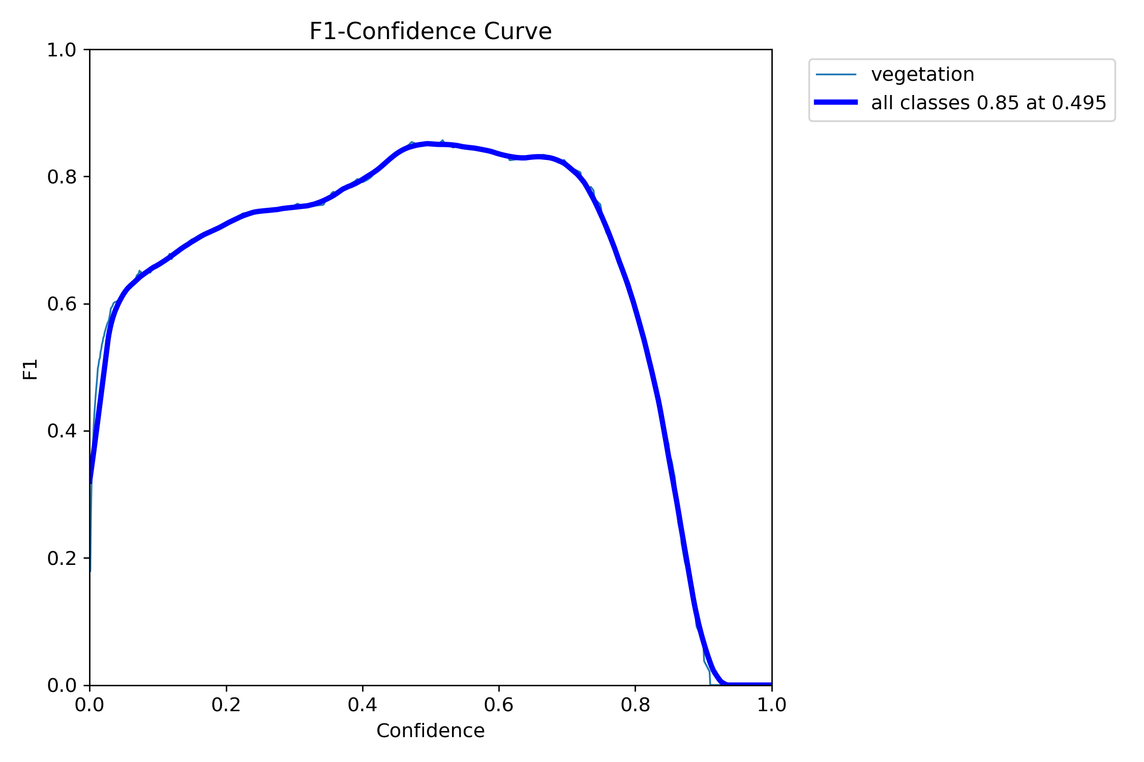
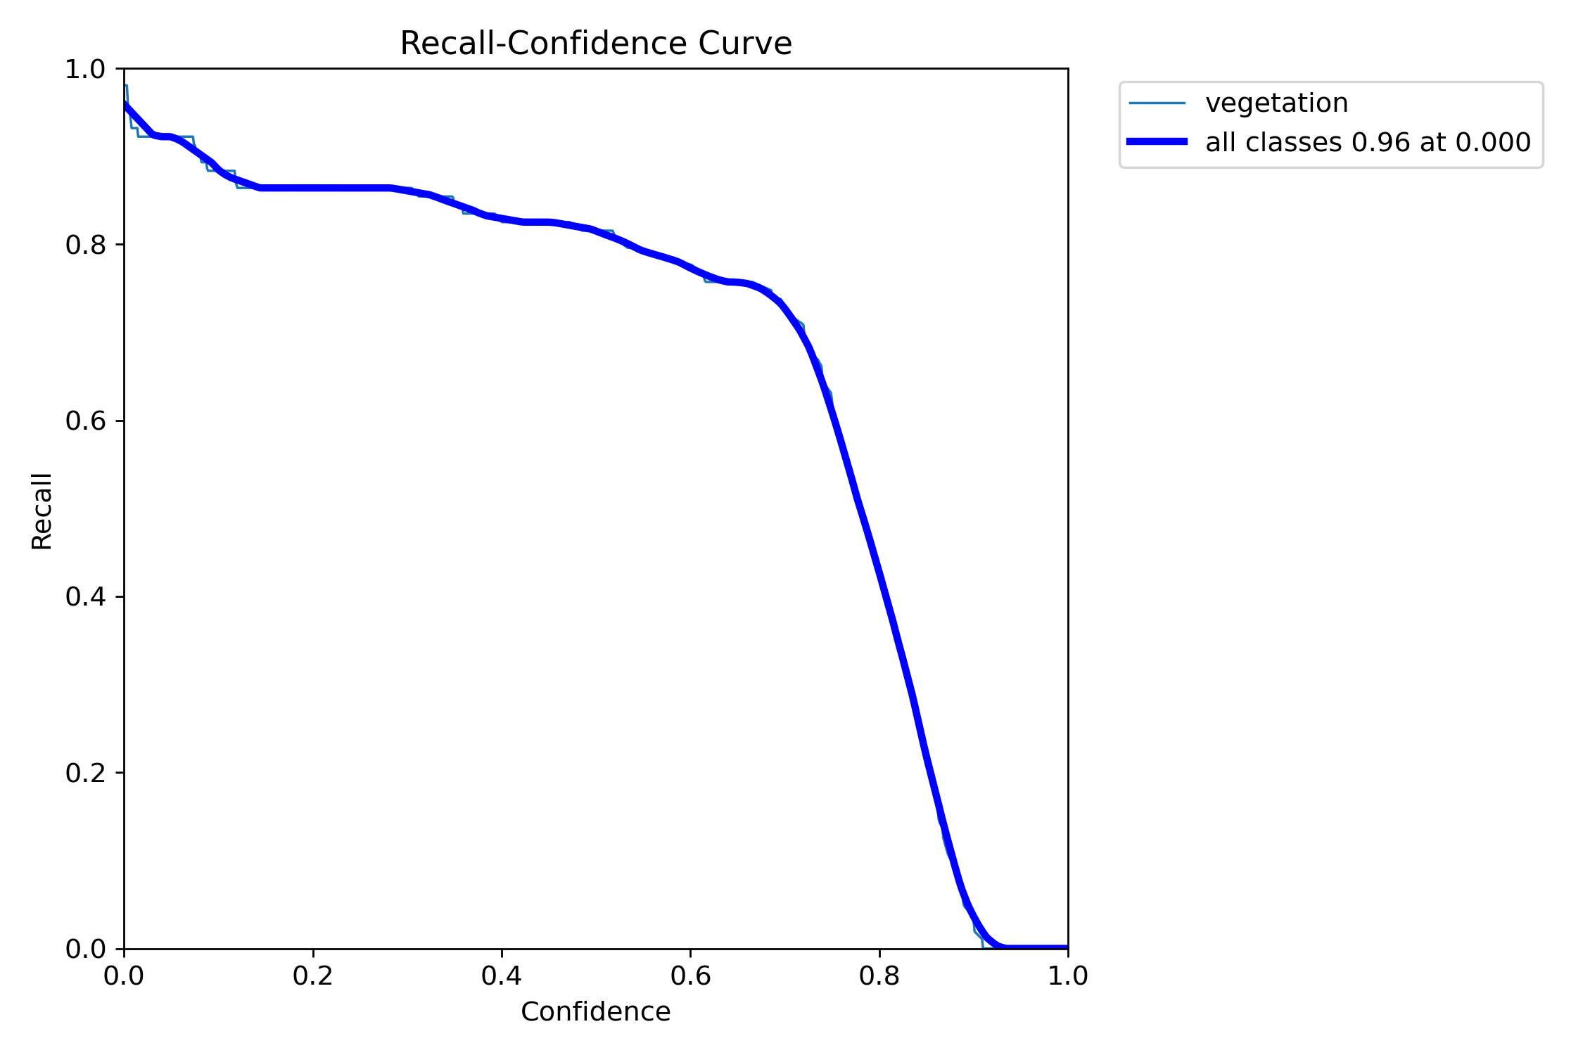
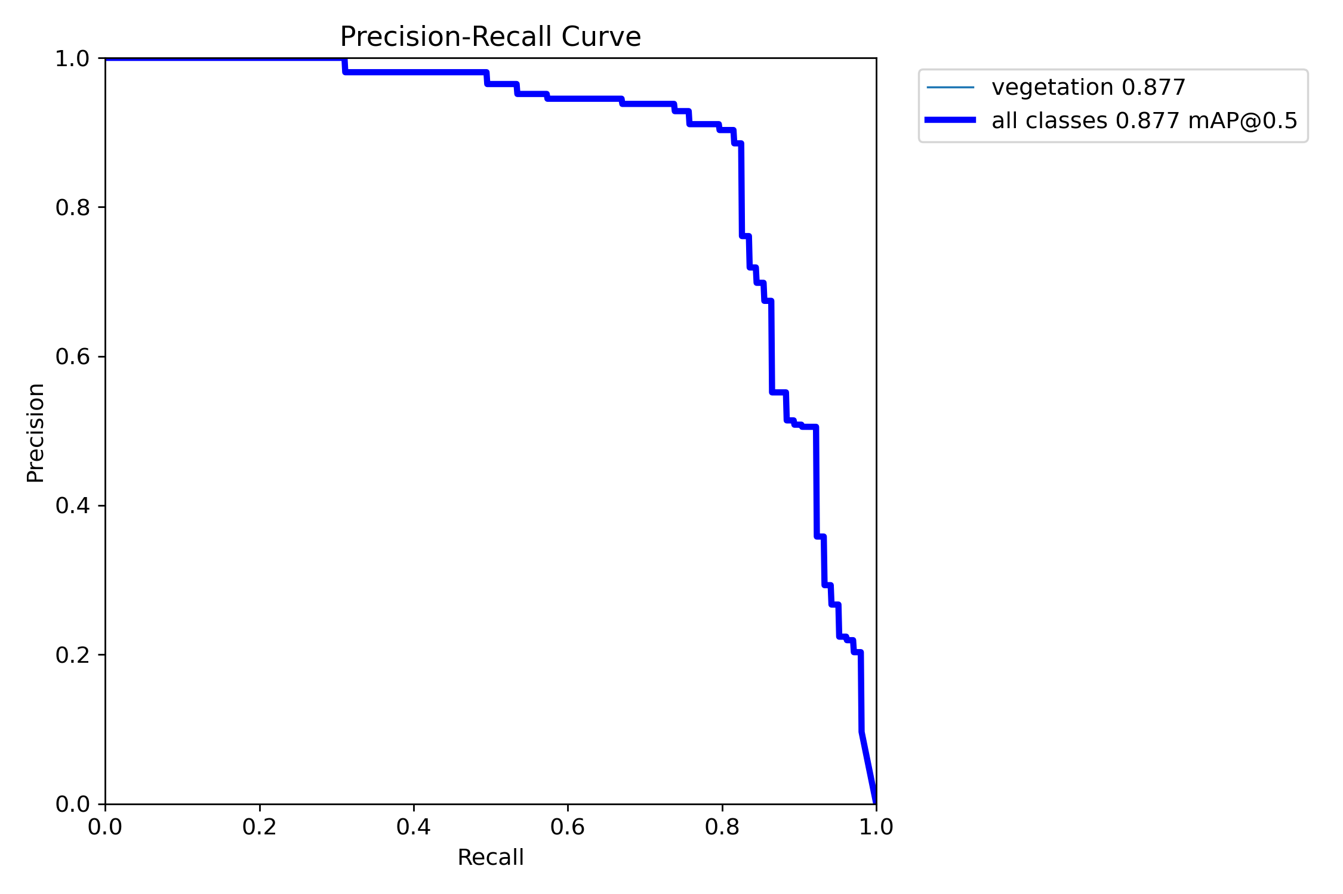
mask

Slide 17
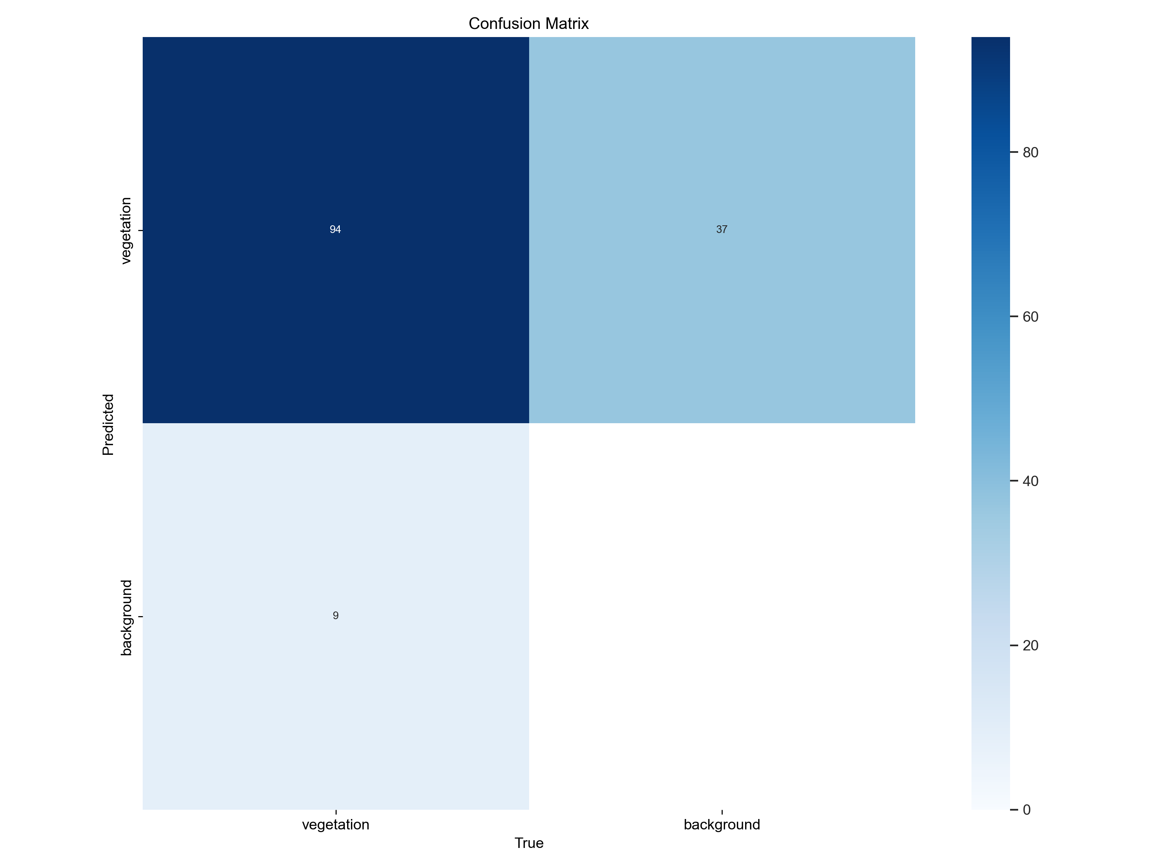
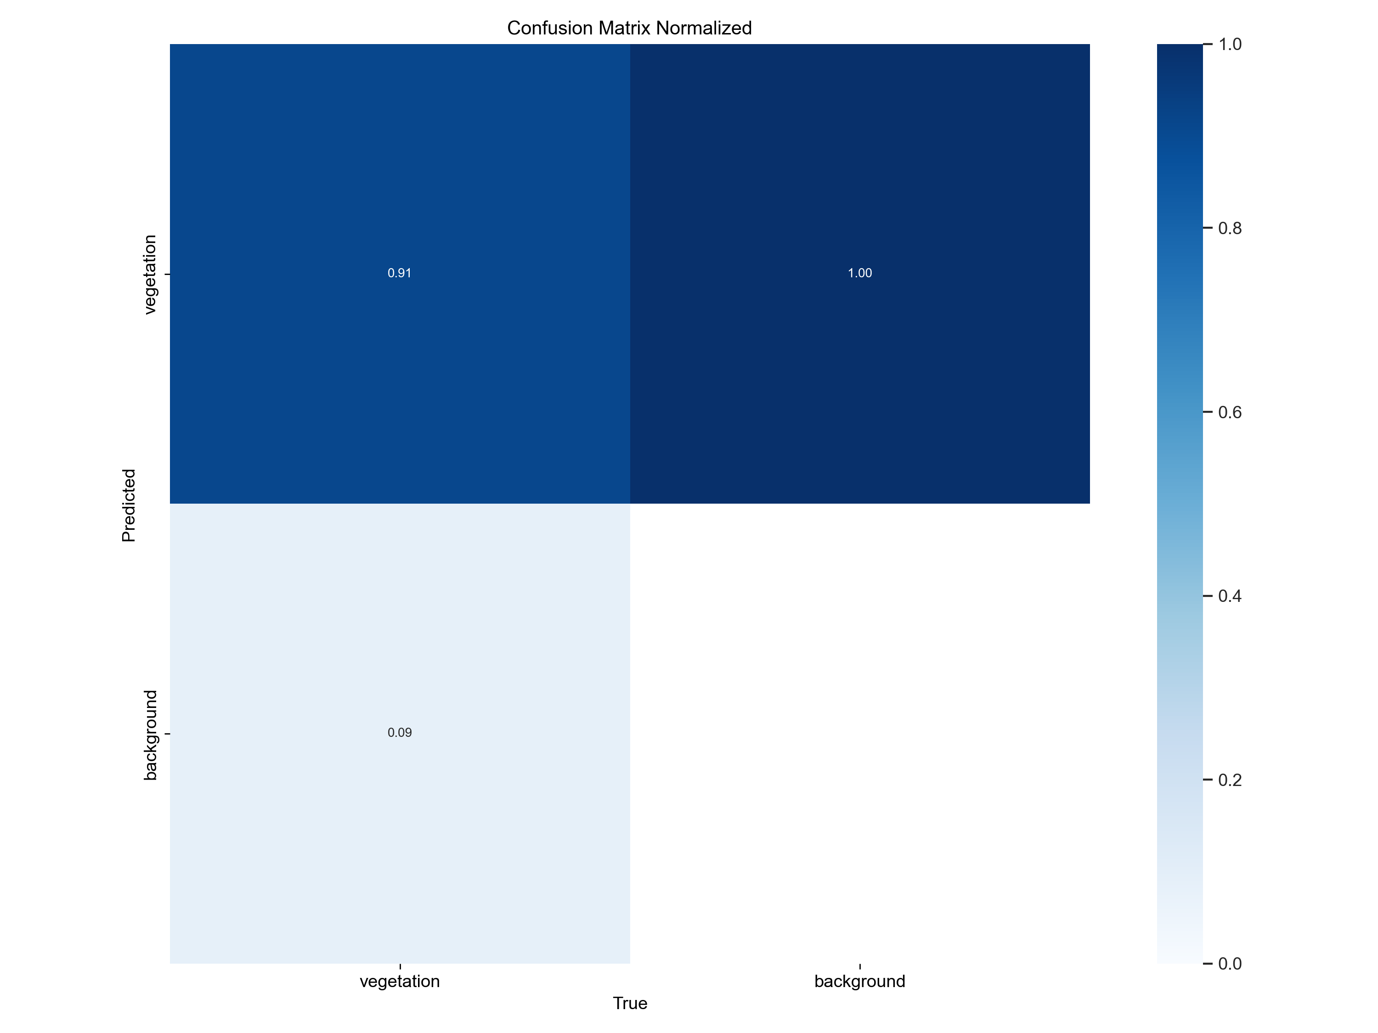
CONFUSION MATRIX

Slide 18
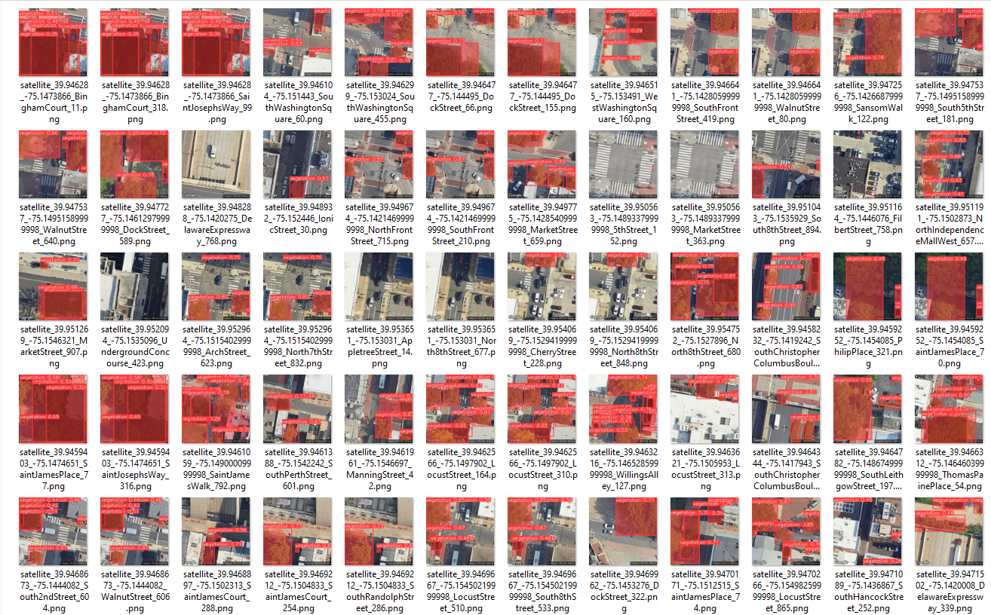
FOLIAGE/VEGETATION INFERENCE RESULTS

Slide 19
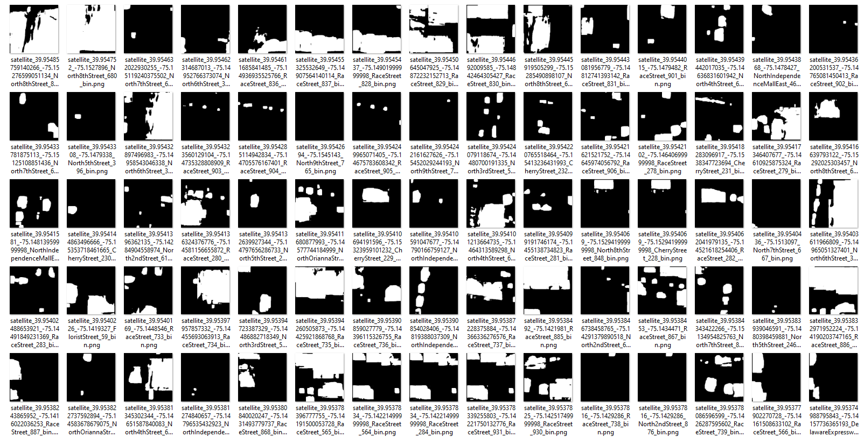
CONVERTING TO BINARY IMAGE FOR GETTING CONTOURS OF FOLIAGE/VEGETATION

Slide 20
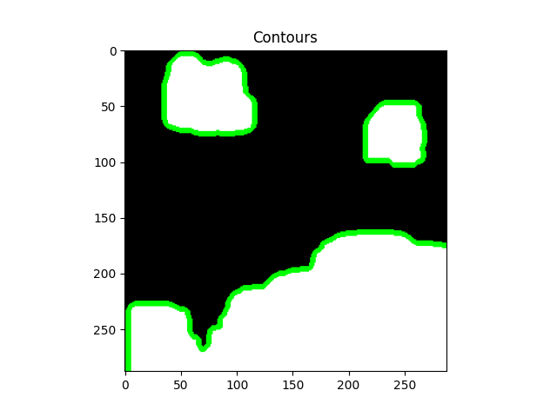
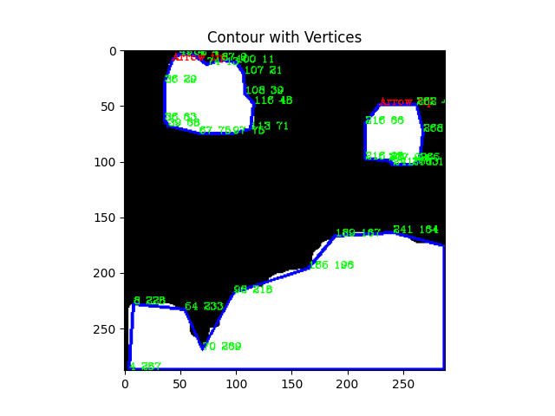
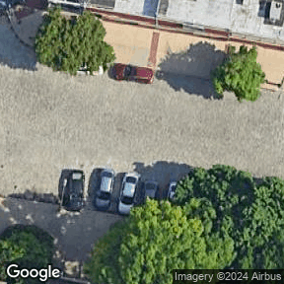
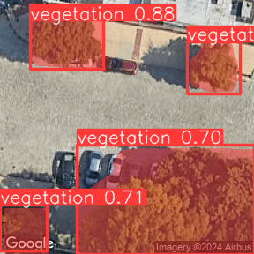
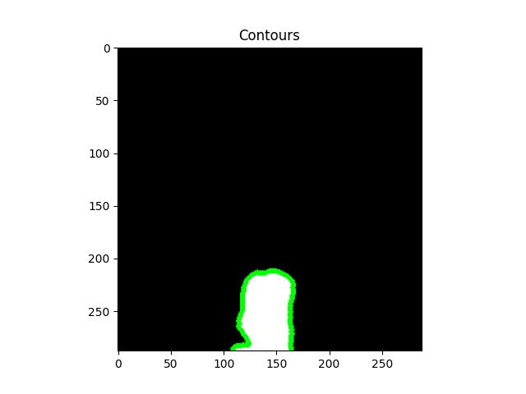
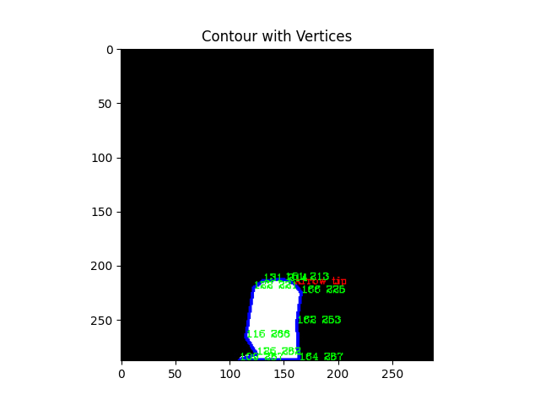
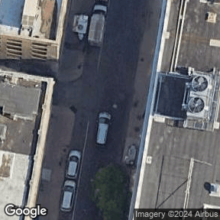
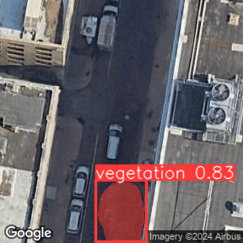
GIS MAPPING AND EXTRACTING FOLIAGE INFORMATION
example 1
Original image
Image with vegetation inference results
Vegetation results to binary image
Vegetation with vertices
example 2
Notes:
SEQUENCE OF STEPS IN EXTRACTING FOLIAGE INFORMATION AND MAPPING TO GIS

Slide 21

FOLIAGE/VEGETATION INFERENCE RESULTS

Slide 22

DT DETECTED VEGETATION IN THE REGION

Slide 23

DETECTED VEGETATION OF REGION (WITH UNDERLYING GOOGLE SATELLITE MAP)

Slide 24
Assumptions
Data Availability and Quality
High-Resolution Imagery
Consistent Data Collection
Accurate Metadata
Technological Capabilities
Advanced Sensors
Robust Computational Resources
Modeling and Simulation
Algorithm Efficiency
Preprocessing Accuracy
Geospatial Accuracy
Precise Georeferencing
Stable Reference Points
Environmental Factors
Stable Environmental Conditions
Consistent Vegetation Growth Patterns
Data Integration and Fusion
Compatibility of Data Sources
Synchronization of Temporal Data
Analytical Techniques
Feature Extraction Accuracy
Dimensionality Reduction
Interpretability and Validation
Model Interpretability
Validation with Ground Truth Data
User and Stakeholder Engagement
Stakeholder Input
Clear Communication
Iterative Improvement
Continuous Improvement
Adaptive Algorithms
Limitations
Data Quality and Availability
Limited Access to High-Resolution Data
Inconsistent Data Collection
Noise and Artifacts
Technological Constraints
Computational Power
Sensor Limitations
Modeling Challenges
Algorithm Performance
Dimensionality Reduction Trade-offs
Geospatial Accuracy
Georeferencing Errors
Temporal Changes
Integration and Fusion Issues:
Data Compatibility
Synchronization Difficulties
Interpretability and Validation
Limited Ground Truth Data
Complex Model Interpretability
Environmental Factors
Dynamic Nature of Foliage
Impact of Obstructions
Delimitations
Scope of Study
Geographical Boundaries
Type of Vegetation
Temporal Range
Fixed Time Periods
Update Frequency
Technological Focus
Selected Algorithms
Data Sources
Methodological Choices
Preprocessing Techniques
Feature Extraction Methods
Stakeholder Involvement
Target Audience
Decision-Making Focus
Validation Approach
Comparison with Specific Benchmarks
Error Metrics

Slide 25

DTRF RESULTS
Comparison of foliage/vegetation from LiDAR and DT
FOLIAGE FROM LiDAR
FOLIAGE FROM DT

Slide 26


REGION OF INTEREST WITH SUB SAMPLE REGIONS
Area in square meter

Slide 27

SAMPLE AREA FOR COMPARISON WITH LIDAR VS DTRF

Slide 28



Digital Twin Representation of Foliage Conversion to Grids
Creating 1x1 sq. m. Grid to
Sample region1
Marking foliage presence in 1x1 sq. m. Grids
Foliage from DT of Sample region1

Slide 29



LiDAR Foliage Conversion to Grids
Creating 1x1 sq. m. Grid to
Sample region1
Marking foliage presence in 1x1 sq. m. Grids
Foliage from LiDAR of Sample region1

Slide 30


FOLIAGE FROM DT & LIDAR (SAMPLE REGION 1)
Common foliage
Foliage from LiDAR
Foliage from DT

Slide 31

Common foliage
Foliage from LiDAR
Foliage from DT
FOLIAGE FROM DT & LIDAR (SAMPLE REGION 1)

Slide 32




SAMPLE REGION 2
Region 2
Region 2 – LiDAR foliage
Region 2 – DT foliage
Region 2 – foliage to grid mapping

Slide 33




SAMPLE REGION 3
Region 3
Region 3 – LiDAR foliage
Region 3 – DT foliage
Region 3 – foliage to grid mapping

Slide 34


Common foliage
Foliage from LiDAR
Foliage from DT
Sub region (1)

Slide 35



Sub region (2)

Slide 36



Sub region (3)

Slide 37


COMPARING DATA COLLECTED AT DIFFERENT TIMES
x
x
Common foliage
Foliage from LiDAR
Foliage from DT
Notes:
Problem with Data comparison of data collected at different times.

Slide 38
THANK YOU
Thank you for your attention.
Are there any questions?

Slide 39
REFERENCES
Notes:
SLIDE INSTRUCTIONS:
Put your references in alphabetical order on the slides. Will require more than one slide.
NOTE: You can choose to put the references that only apply to your slides, or you can put all the references from your dissertation on these slides.

